Slide 1



Week - 10 Leadership & People Management in Agile Projects ISM 6930 – 3 Credit Hours Special Topics (Agile Project Management - APM) Spring, 2018; Room: A205 (12:00pm to 2:45pm) Dr. Bhuvan UNHELKAR IT Faculty, College Of Business; Office: C225; bunhelkar@sar.usf.edu; 941-359-4654

Slide 2

Agenda
Leadership and People Management in Agile Projects (Page 293 – 303)
Leadership versus Management
CAMS Project Structure
Transactional Analysis (TA)
Myers-Briggs Type Indicator (MBTI)
"Agile job aids" (Selected Agile Practices).
Study of Agile Practice 2 & 9: User Persona; Backlog Management
Summary & Consolidation

Slide 3

Sub-Module Leadership
A fuzzy “Art”
© MethodScience; Material Designed and Presented by Dr. B. Unhelkar; drawn from The Art of Agile Practice

Slide 4
Leadership
Crucial for “Agile Project Management”
Different to Management
Although, may require Management
Dynamic – continuously changing in the Team
Roles, Ceremonies, Artifact are ALL changing
All successful Projects have substantial element of Leadership
BUT, its difficult to train in; and difficult to measure

Slide 5
Figure 8.11: Leadership versus Management
Value-based; Fuzzy; Risky; Agile (Synchronous Team)
Task-based; Measurable; Planned (Closed Team)
Subjective
Balancing
The Two
CAMS
Objective
Notes:
Relate this to Figure 8.2
Leadership is a key element of Agile projects. Its heavily focused on value rather than task completion.
Therefore, it is not easily measurable and comparatively risky.

Slide 6
Agile Leadership
Agile Leader enables the Team to Grow
Agile Leadership Characteristics:
Constantly keeps Project goals in front of the Team using various means and mechanisms
Continuously Facilitates interactions and cooperation among team members
Strives to Improve intra-team dynamics
Encourages and Supports collaboration amongst team members
Anticipates changes and prepares for it
Encourages decision making amongst team
Works to Removes obstacles

Slide 7
Shift from Project Manager to Scrum Master
In Scrum, each team member is responsible to report at each Daily scrum:
Changes since the last Daily Scrum
The task for next Daily Scrum
Obstruction to achieving their task
In Contracts, Traditional Project manager following Scrum interpret the above as:
Check whether the team members had done their task since the last Daily Scrum
Set task for the next Daily Scrum
Ensure all obstruction to the task are taken care of.

Slide 8
Understand the responsibility of the ScrumMaster
Understanding the role and responsibility of Scrum Master
The team needs to sense the dedication of the Scrum Master to team welfare
Attitude reflect the importance of the project
Understand the shift from having authority to being a facilitator (manager to leader)
Understand the importance of the duties rather than the roles assigned
Shift from delegating to being responsible

Slide 9
Project Manager versus Scrum Master
ScrumMaster role is different from Project Manager
ScrumMaster need to fulfil his responsibility as well as embed Scrum practices and rules
To summarise the responsibilities of ScrumMaster are:
Remove the barriers between project owner and development
Teach the project owner to meet their objectives and optimize ROI by using Scrum
Facilitate empowerment and creativity of the development team and improve lives
Improve productivity
Improve engineering tools and practices
Keep information of team’s progress current and visible

Slide 10
Sub-Module Team Formations - II
Some Underlying Techniques & Philosophies of Agile Teams
© MethodScience; Material Designed and Presented by Dr. B. Unhelkar; drawn from The Art of Agile Practice

Slide 11
Leading the Agile Team
Agile Leader needs to ensure work happens without interruption for the 30 day Sprint.
Agile Leader facilitates selection from the Product Backlog, until its turned into an increment of potentially shippable product in 30 calendar days.
Once the team commits to a Sprint the clock starts ticking and the team does whatever is required to meet its commitment – and the Leader steps out of the way.

Slide 12
Figure 8.12: Project Team Structures – CAMS
Business Architect
Domain Specialist (SME)
Quality Manager (QM)
Requirements Modeler (RM)
Auditors Lawyers
Accountants
Business Administration
Enterprise Architect (EA)
Project Manager (PM)
Developers Implementer
User Experience Analyst
Users
Testers
Directors…
Executive
CAMS
Advisor
Business Analyst (BA)
Key
Stakeholders
Formal & Agile
Project Roles
12

Slide 13
Figure 8.13: CAMS Team Organizational Models (based on Constantine 1989)
Traditional ; Hierarchical
Closed
Self-Organized; Agile
Open
Synchronous
Random

Slide 14
Sub-Module Transactional Analysis (TA)
Eric Berne’s very simple, practical psycho-social Framework of immense value in Agile Teams
© MethodScience; Material Designed and Presented by Dr. B. Unhelkar; drawn from The Art of Agile Practice

Slide 15
Figure 8.14: TA Life positions and Corresponding Team Structures
I am OK
Open
Random
Closed
Synchronous
You are Not OK
You are OK
Dysfunctional
Rebellious
I am Not OK

Slide 16
Figure 8.15: A Homogeneous Smoothly Functioning Synchronous Team is based on the Best Fit Approach
A “+ --”
Person
X
✓
X
A “-- +”
Person
A “+ +” Team

Slide 17
Figure 8.16: Flattening the Pyramid (Top View of a “+ +” Team Organization)
m5
m1
m4
Leader
(Facilitator)
External
Parties
Internal
Parties
m2
m3
Project Boundary

Slide 18
Sub-Module Myers Briggs Type Indicator [MBTI]
A Personality Test
© MethodScience; Material Designed and Presented by Dr. B. Unhelkar; drawn from The Art of Agile Practice

Slide 19
Cultural Chasms creating Personalities (At the Minimum)
Gender – Male v Female; Preconceptions; Cultural influence
Language – Spoken-Written; Technical-Business; Verbal-NonVerbal
Faith – May set Priority;
Country – Legal-Cultural priorities
Age [Generation Gap] – Use of Technology; Mannerism;
Dress code – Tie, Shoes, Colour
Technology – Mobiles & SMS; Emails;

Slide 20
Myers-Briggs Type Indicator (MBTI).
MBTI is made up of four pairs of personality traits. These personalities are
E = extroversion, I = introversion,
S = sensing, N = intuition,
T = thinking, F = feeling,
J = judging, and P = perceiving.

Slide 21
Myers-Briggs Personality Quadrants
Attitude towards Source of Energy
Perception & Data Gathering
Decision Making
Attitude towards External World
Extrovert - introvert
Sensing - intuition
Thinking - feeling
Judging - perceiving

Slide 22
Extroversion (E) and Introversion (I): The “E”s are outward going, whereas the “I” personalities prefer to look inwards. The strengths of Es such as being talkative, outgoing, conversation initiators can be used by astute project leaders in placing these individuals in contact with business stakeholders, users and domain experts. The introverts, who are quiet and reserved, can perform better in a CAMS-based project when they deal with enterprise architects and business architects where issues are discussed more from a stability than change viewpoint

Slide 23
Sensing (S) and Intuition (N): S individuals understand and absorb requirements and features in a linear fashion. The N person works through abstraction – taking in information as an insight rather than a logical conclusion. Project leaders in CAMS can use the S individuals much better in the second and third iterations – where the approach to developing features is well established; the N individuals (or individuals exhibiting more of N rather than S characteristics) can be put upfront to develop the features and stories of the very first iteration as these are the people who relish new and exciting tasks that seem to defy logic.

Slide 24
Thinking (T) and Feeling (F): Thinking is focused on the logical, step-by-step way of understanding and solving problems. Feelings in MBTI gives deference to the emotional aspects of decision making. Therefore, the “F” people are given significant opportunity to contribute to Agile projects where the emphasis is on individual’s subjectivity and motivation. Thinking, of course, brings in rigor and firmness in decision making with due input from past project data including metrics and measurements. T people are likely to be comfortable with the planned process aspects of CAMS whereas the F people will be accepting of the fuzziness of the Agile principles and practices in CAMS.

Slide 25
Judging (J) and Perceiving (P): Judging indicates organizational tendencies which can be put to excellent use in planning a project, assigning roles and responsibilities and eventually tracking and controlling the project. These characteristics can be used in the formal, planned aspect of CAMS. Processes and their maturity is also well understood and accepted by the ‘J’ individuals. P, on the other hand, may even appear to be disorganized and seem to be distracted in completing his or her tasks. However, Perceiving individuals are adaptable, spontaneous and open-ended and, thereby, quite Agile. CAMS suggests project leaders to spot these perceiving characteristics and make provisions for them in the project. The adherence to timeliness and deadlines, part of the Judging characteristics finds it easier to work with the planned aspect of a CAMS project.

Slide 26
MBTI - www.myersbriggs.org
ISTJ Quiet, serious, earn success by thoroughness and dependability. Practical, matter-of-fact, realistic, and responsible. | ISTP Tolerant and flexible, quiet observers until a problem appears, then act quickly to find workable solutions. Analyze what makes things work
ISFJ Quiet, friendly, responsible, and conscientious. Committed and steady in meeting their obligations. Thorough, painstaking, and accurate. | Quiet, friendly, sensitive, and kind. Enjoy the present moment, what’s going on around them. Like to have their own space and to work within their own time frame.
INFJ Seek meaning and connection in ideas, relationships, and material possessions. Want to understand what motivates people and are insightful about others. | INFP Idealistic, loyal to their values and to people who are important to them. Want an external life that is congruent with their values.
INTJ Have original minds and great drive for implementing their ideas and achieving their goals. Quickly see patterns in external events and develop long-range explanatory perspectives. | INTP Seek to develop logical explanations for everything that interests them. Theoretical and abstract, interested more in ideas than in social interaction.
Notes:
Based on Introduction to Type® by Isabel Briggs Myers published by CPP. Inc
Please visit: http://www.myersbriggs.org/my-mbti-personality-type/mbti-basics/the-16-mbti-types.asp

Slide 27
MBTI - www.myersbriggs.org
ESTP Flexible and tolerant, they take a pragmatic approach focused on immediate results. Theories and conceptual explanations bore them | ESTJ Practical, realistic, matter-of-fact. Decisive, quickly move to implement decisions. Organize projects and people to get things done
ESFP Outgoing, friendly, and accepting. Exuberant lovers of life, people, and material comforts. Enjoy working with others to make things happen. | ESFJ Warmhearted, conscientious, and cooperative. Want harmony in their environment, work with determination to establish it. Like to work with others to complete tasks accurately and on time.
ENFP Warmly enthusiastic and imaginative. See life as full of possibilities. Make connections between events and information very quickly, | ENFJ Warm, empathetic, responsive, and responsible. Highly attuned to the emotions, needs, and motivations of others. Find potential in everyone, want to help others fulfill their potential
ENTP Quick, ingenious, stimulating, alert, and outspoken. Resourceful in solving new and challenging problems. Adept at generating conceptual possibilities and then analyzing them strategically. | Frank, decisive, assume leadership readily. Quickly see illogical and inefficient procedures and policies, develop and implement comprehensive systems to solve organizational problems.
Notes:
Based on Introduction to Type® by Isabel Briggs Myers published by CPP. Inc
Please visit: http://www.myersbriggs.org/my-mbti-personality-type/mbti-basics/the-16-mbti-types.asp

Slide 28
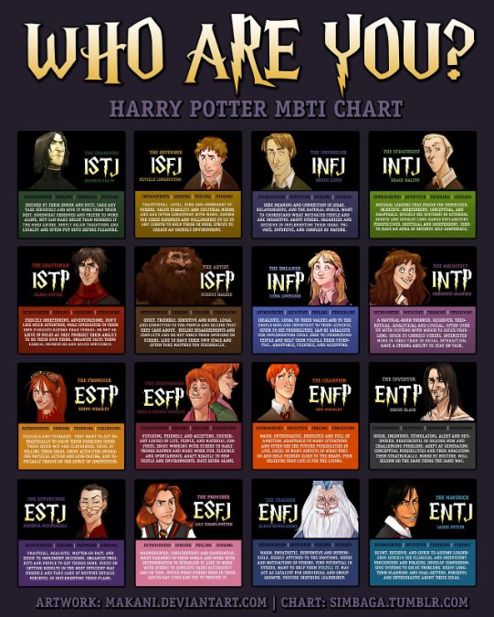
http://m.c.lnkd.licdn.com/mpr/mpr/p/3/005/014/161/3c2262b.jpg
Notes:
http://m.c.lnkd.licdn.com/mpr/mpr/p/3/005/014/161/3c2262b.jpg

Slide 29
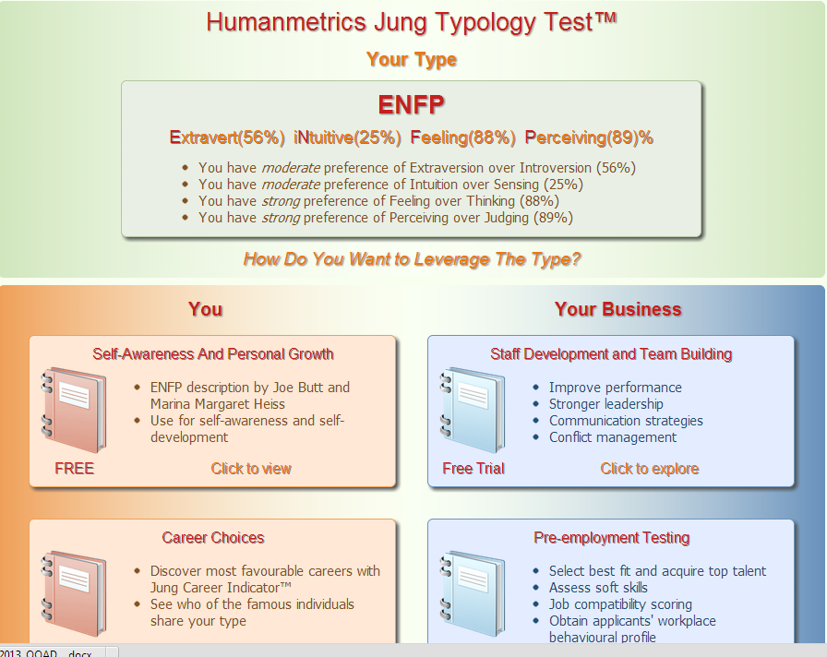
Free Personality Test from - http://www.humanmetrics.com/cgi-win/jtypes2.asp
ENFP Warmly enthusiastic and imaginative. See life as full of possibilities. Make connections between events and information very quickly,

Slide 30

Exercise
Undertake a Self-analysis of your own Personality Type (you will have to access the Internet and visit the site –
http://www.humanmetrics.com/cgi-win/jtypes2.asp
We utilize our understanding of personalities to carry out Successful negotiations
To NOT cross Paths

Slide 31


Discussion, Q & A
How do you compare the Leadership challenges of Agile Teams with the Traditional (Hierarchical) Teams?
Comment on the challenges of using MBTI type Personality tests in practice? (hint: Do not / Can not force tests on Team Members)

Slide 32
Sub-Module Agile Job Aids – 2 = User Persona; 9 = Backlog Management
And a Discussion Question
© MethodScience; Material Designed and Presented by Dr. B. Unhelkar

Slide 33


Slide 34
Sub-Module Agile Teams
Cross-Functional; Co-Located;
© MethodScience; Material drawn from The Art of Agile Practice (B. Unhelkar)

Slide 35

Team-Awesome (OzAir – Project: Airline Booking System -ABS)
Evan Barniskis
Hasena “Stacy” Dukhi
Mary Helmle
John Holdway
Joel Lengyel

Slide 36
Team-Best (Desi Travels: Project – Travel Management System - TMS)
Michael Myers
Christopher Nothdurft
Nikki Orth
A Zahidur Rahman

Slide 37
Team-Champions (Lucky Insurance: Project – Insurance Management System - IMS)
Stanley Abada
Rafael Adames
Sumner Darling
Yves Lexis
Mark Richman

Slide 38
Conclusions & Future Directions
We discussed…??
Do you see what we see?

